Slide 1
Celluoid Shading

Slide 2
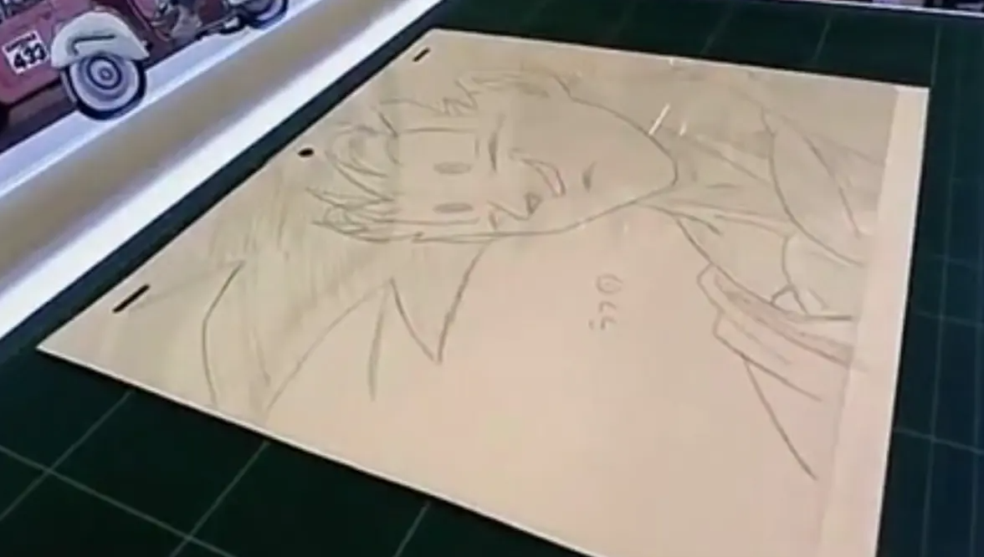
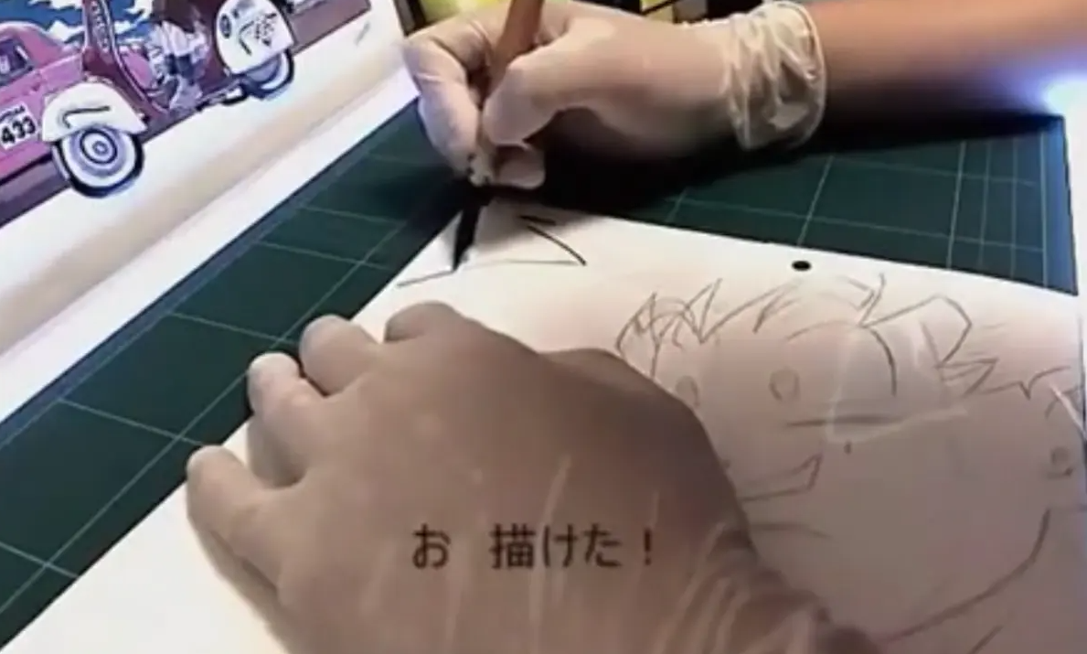
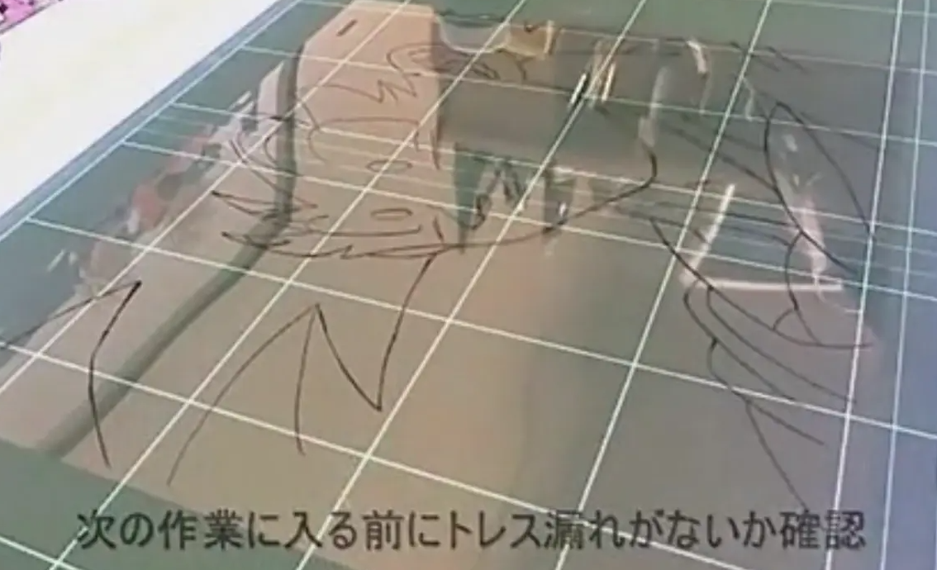
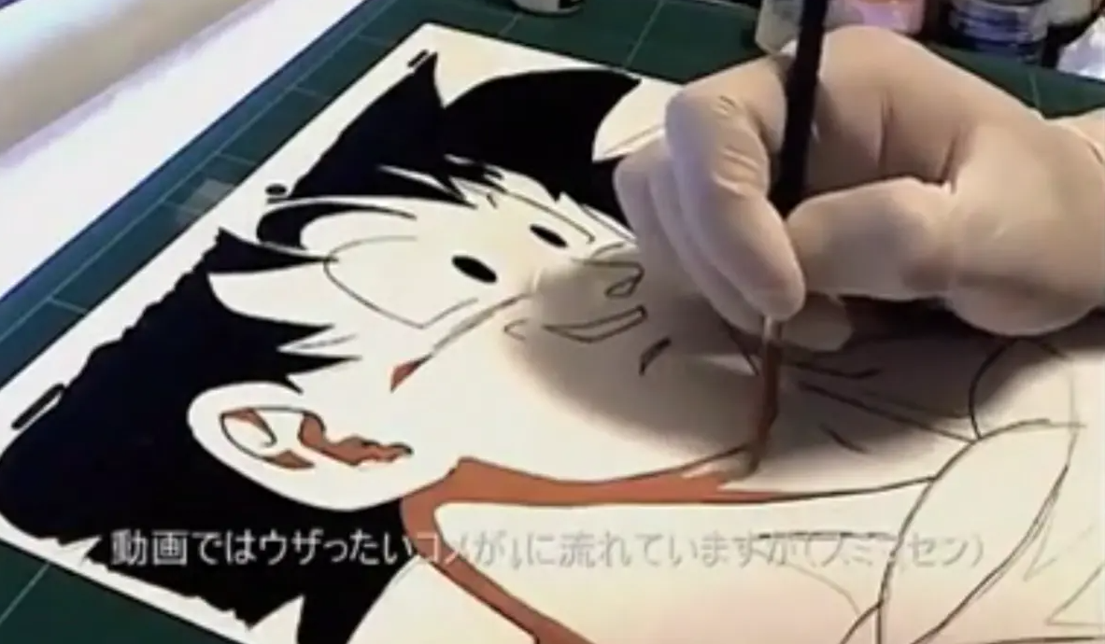
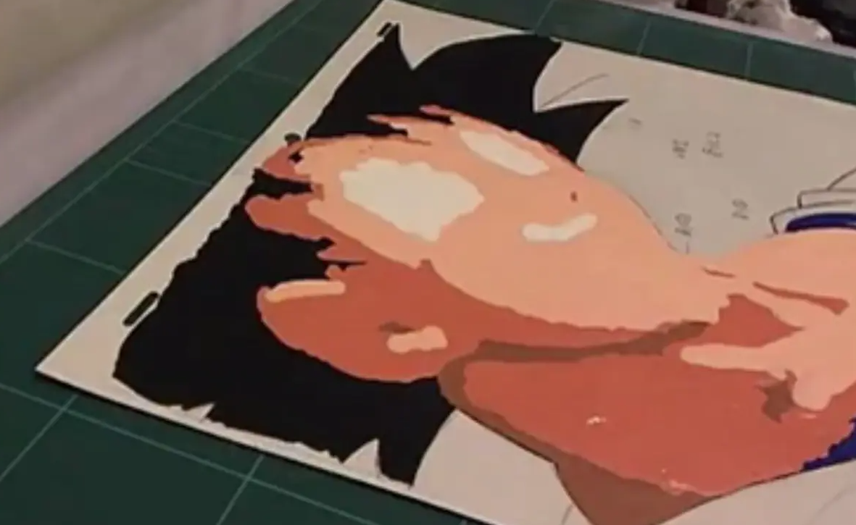
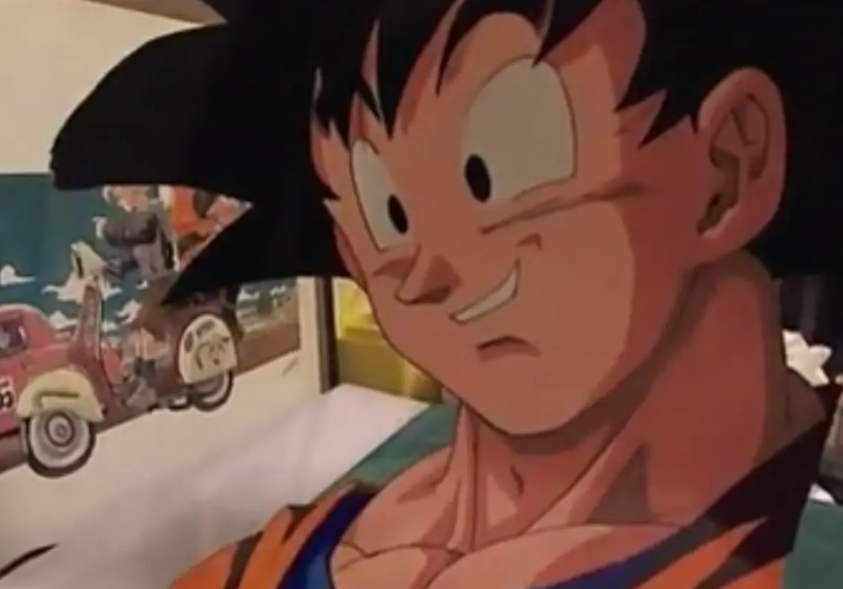
Celluoid

Slide 4
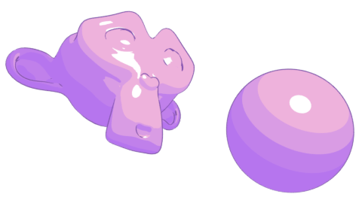

Outline
Color level

Slide 5
Outline

Slide 6
Motomura_Junya_GuiltyGearXrd

Slide 7
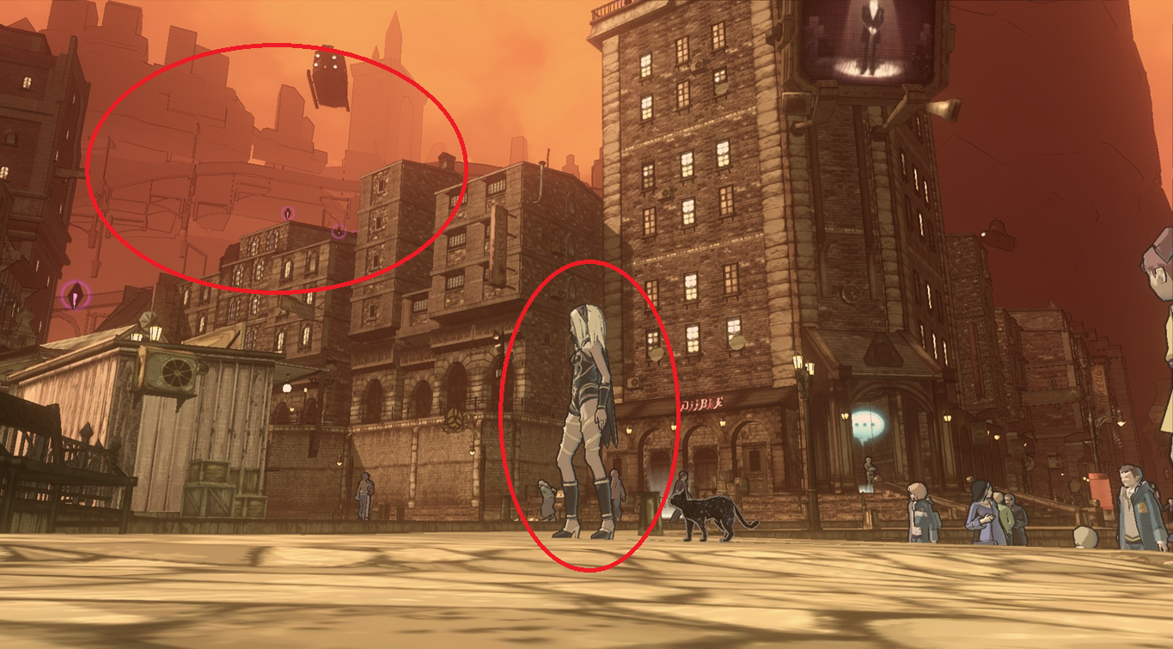

Slide 8
Shading

Slide 9
Step(Threshold, dot(L, N))
Normal edit
ILM texture
SSS texture

Slide 10
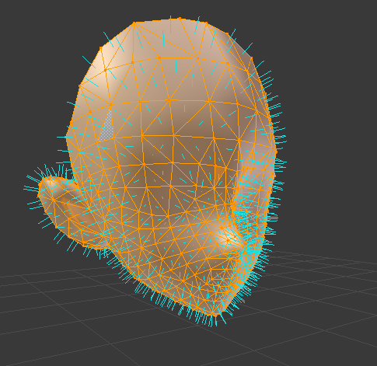

Slide 11
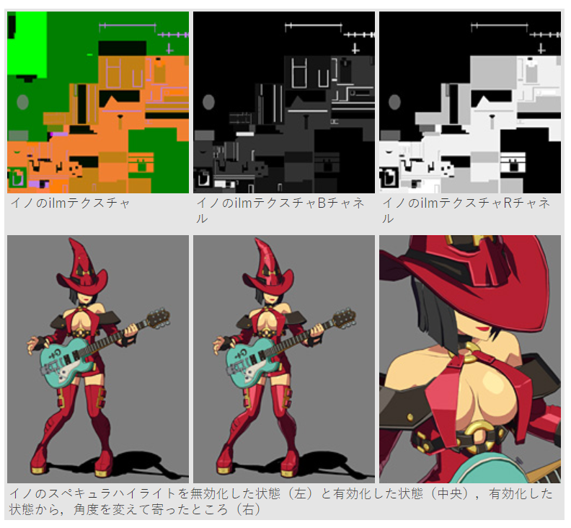
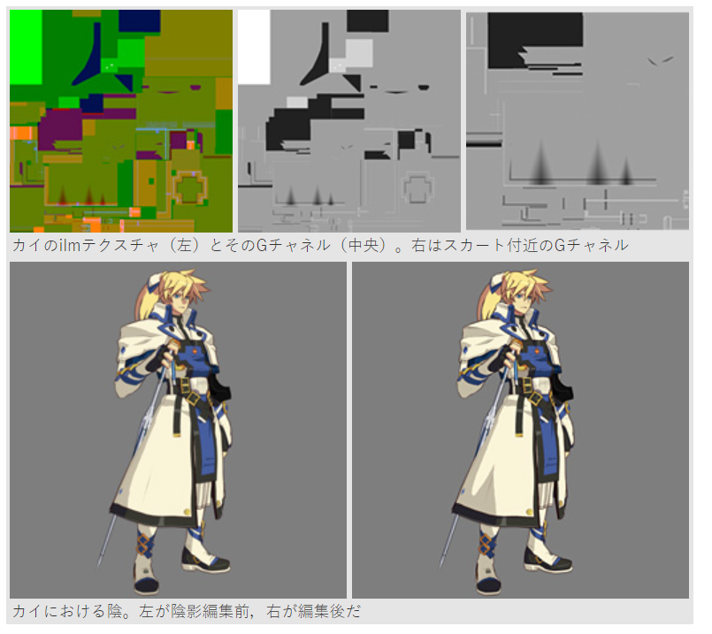
ILM Texture

Slide 12
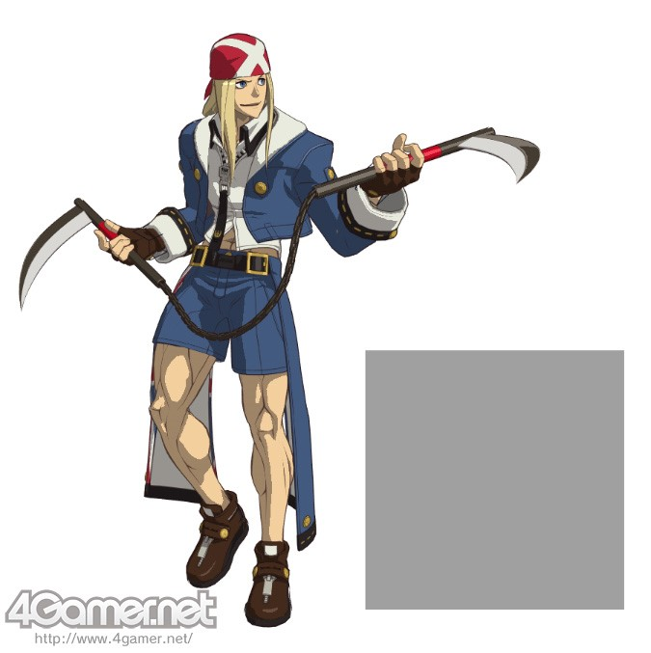
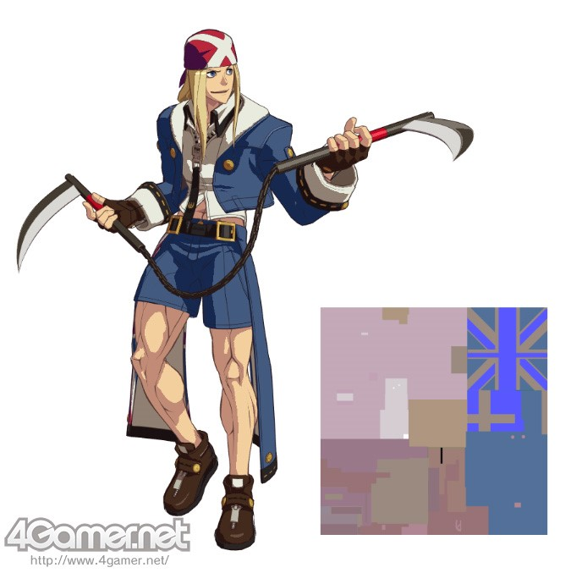
SSS Texture

Slide 13
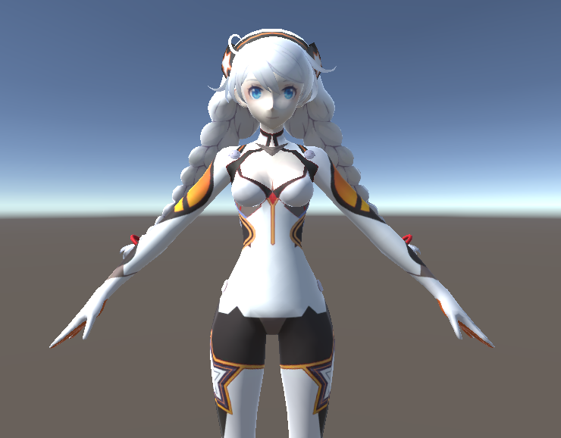
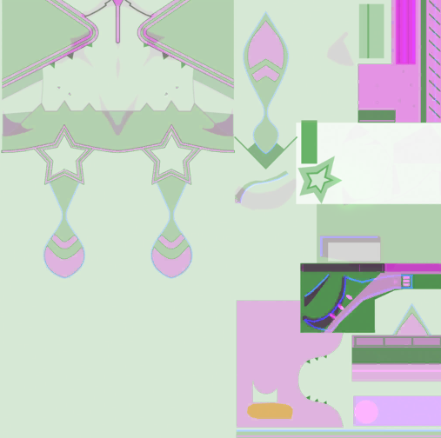


+
Standard
LightMap

Slide 14
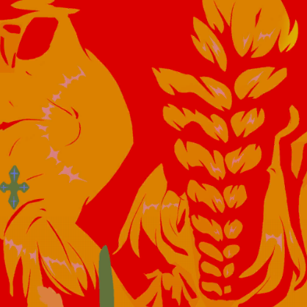
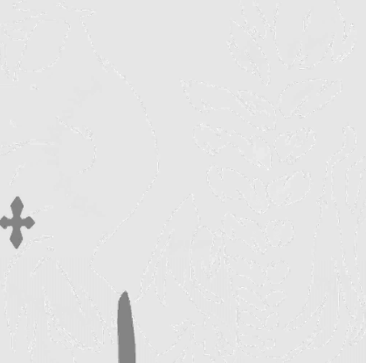

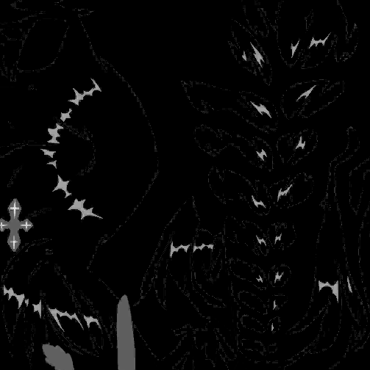
R
G
B

Slide 15
R
G
B

Slide 16
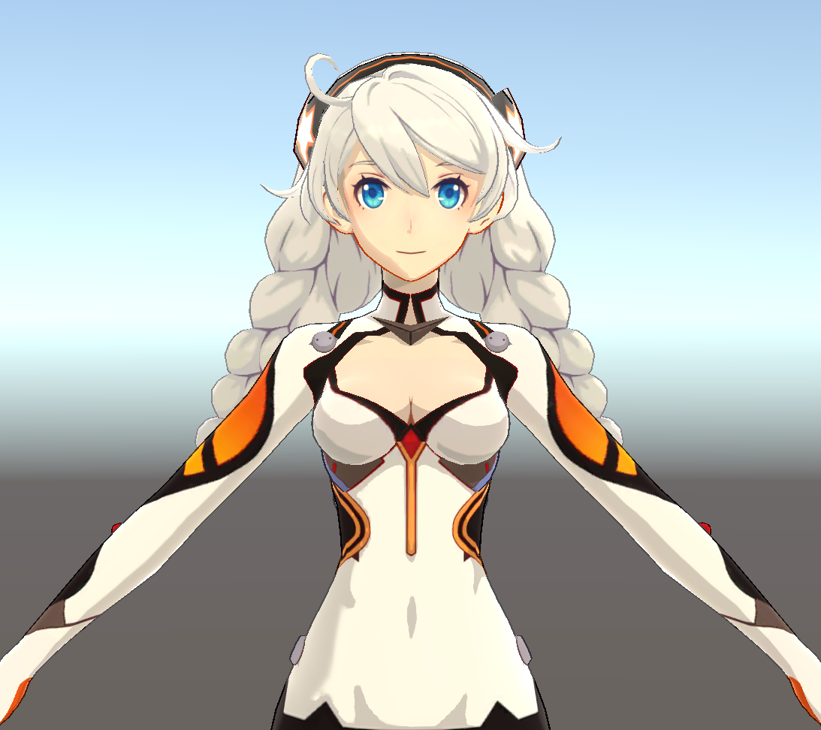
+
Standard
LightMap

Slide 17
Summerize

Slide 18
References
https://www.4gamer.net/games/216/G021678/20140703095/index_2.html
https://zhuanlan.zhihu.com/c_1183802694685433856
https://www.youtube.com/watch?v=yhGjCzxJV3E
GuiltyGear Xrd’s Art Style : The X Factor Between 2D and 3D

